Slide 1

Regression
Lecture 4 Instruction
Introduction to Data Science (IDS) course

Slide 2
Simple Linear Regression Examples
Height (cm) | Weight (kg)
160 | 57
162 | 54
167 | 64
175 | 71
175 | 73
180 | 70
180 | 76
182 | 74
185 | 82
190 | 94
Exercise:
Calculate a linear regression model that predicts the weight of a person based on their height.

Slide 3
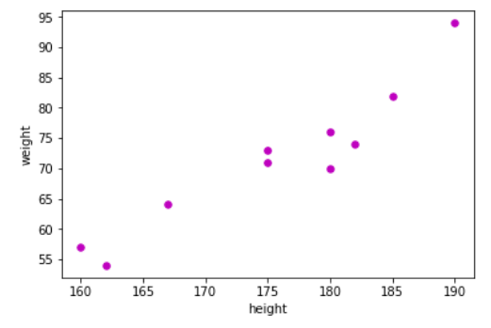
Simple Linear Regression Example
Height (cm) | Weight (kg)
160 | 57
162 | 54
167 | 64
175 | 71
175 | 73
180 | 70
180 | 76
182 | 74
185 | 82
190 | 94
First we plot the data

Slide 4
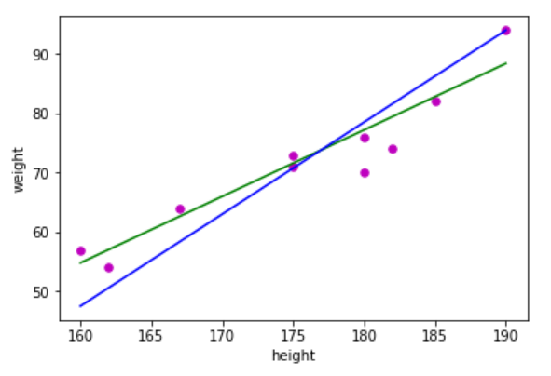
Simple Linear Regression Example
Height (cm) | Weight (kg)
160 | 57
162 | 54
167 | 64
175 | 71
175 | 73
180 | 70
180 | 76
182 | 74
185 | 82
190 | 94
We try to fit a linear function to our data points: y = b + wx

Slide 5


Simple Linear Regression Example
But which line fits our data best?
Blue:
Green:
Basic idea:
Calculate the sum of squared errors and pick the function that reports the smaller value

Slide 6


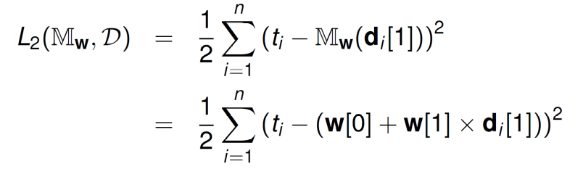
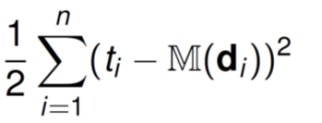
Simple Linear Regression Example
Basic idea:
Calculate the sum of squared errors and pick the function that reports the smaller value
Blue:
Green:
x | y | Prediction | Error | Error² | Prediction | Error | Error²
160 | 57 | 47.5 | 9.5 | 90.25 | 54.79 | 2.21 | 4.88
162 | 54 | 50.6 | 3.4 | 11.56 | 57.03 | -3.03 | 9.18
167 | 64 | 58.35 | 5.65 | 31.92 | 62.63 | 1.37 | 1.88
175 | 71 | 70.75 | 0.25 | 0.06 | 71.59 | -0.59 | 0.35
175 | 73 | 70.75 | 2.25 | 5.06 | 71.59 | 1.41 | 1.98
180 | 70 | 78.5 | -8.5 | 72.25 | 77.19 | -7.19 | 51.70
180 | 76 | 78.5 | -2.5 | 6.25 | 77.19 | -1.19 | 1.42
182 | 74 | 81.60 | -7.60 | 57.76 | 79.43 | -5.43 | 29.48
185 | 82 | 86.25 | -4.25 | 18.06 | 82.79 | -0.79 | 0.62
190 | 94 | 94 | 0 | 0 | 88.39 | 5.61 | 31.47
model
data
observed value
predicted value

Slide 7
Simple Linear Regression Example
Basic idea:
Calculate the sum of squared errors and pick the function that reports the smaller value
Blue: L₂ = 146,585
Green: L₂ = 33,47
x | y | Prediction | Error | Error² | Prediction | Error | Error²
160 | 57 | 47.5 | 9.5 | 90.25 | 54.79 | 2.21 | 4.88
162 | 54 | 50.6 | 3.4 | 11.56 | 57.03 | -3.03 | 9.18
167 | 64 | 58.35 | 5.65 | 31.92 | 62.63 | 1.37 | 1.88
175 | 71 | 70.75 | 0.25 | 0.06 | 71.59 | -0.59 | 0.35
175 | 73 | 70.75 | 2.25 | 5.06 | 71.59 | 1.41 | 1.98
180 | 70 | 78.5 | -8.5 | 72.25 | 77.19 | -7.19 | 51.70
180 | 76 | 78.5 | -2.5 | 6.25 | 77.19 | -1.19 | 1.42
182 | 74 | 81.60 | -7.60 | 57.76 | 79.43 | -5.43 | 29.48
185 | 82 | 86.25 | -4.25 | 18.06 | 82.79 | -0.79 | 0.62
190 | 94 | 94 | 0 | 0 | 88.39 | 5.61 | 31.47
model
data
observed value
predicted value
293,17
66,94

Slide 8
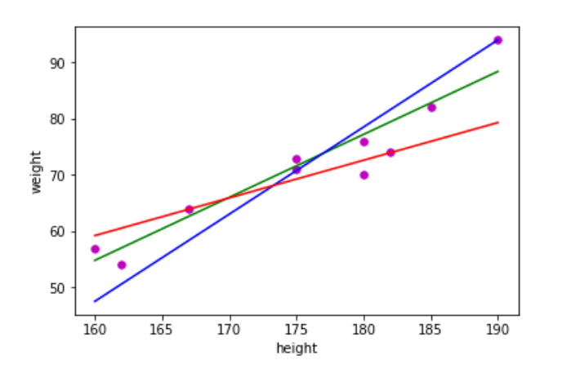

Simple Linear Regression Example
Your turn!
Calculate the sum of squared errors for the red function:
Red:

Slide 9
Simple Linear Regression Example
x | y | Prediction | Error | Error²
160 | 57
162 | 54
167 | 64
175 | 71
175 | 73
180 | 70
180 | 76
182 | 74
185 | 82
190 | 94
Your turn!
Calculate the sum of squared errors for the red function:
Red:

Slide 10
Simple Linear Regression Example
x | y | Prediction | Error | Error²
160 | 57 | 59.2 | -2.20 | 4.84
162 | 54 | 60.54 | -6.54 | 42.77
167 | 64 | 63.89 | 0.11 | 0.01
175 | 71 | 69.25 | 1.75 | 3.06
175 | 73 | 69.25 | 3.75 | 14.06
180 | 70 | 72.60 | -2.60 | 6.76
180 | 76 | 72.60 | 3.40 | 11.56
182 | 74 | 73.94 | 0.06 | 0.004
185 | 82 | 75.95 | 6.05 | 36.60
190 | 94 | 79.30 | 14.70 | 216.1
Your turn! - Solution
Calculate the sum of squared errors for the red function:
Red:
Sum of squared errors: 335.76
L₂: 167,88

Slide 11
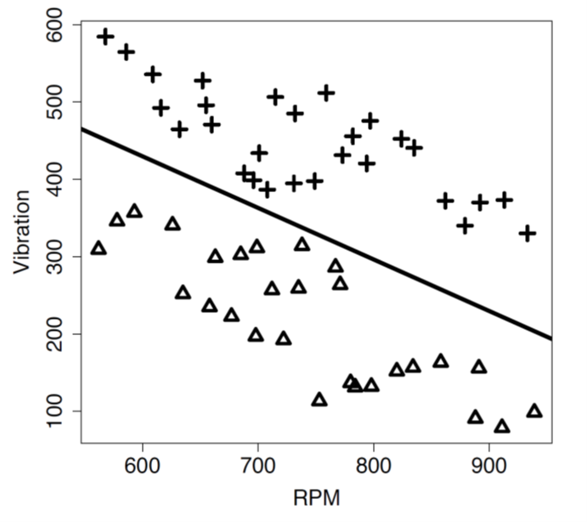
Logistic Regression Example
Linear function is separating rather than predicting!
Logistic regression function shown in the picture:
Exercise:
RPM = 800, Vibration = 400 will be classified as +.
What about RPM = 600, Vibration = 500?

Slide 12
Logistic Regression Example
Exercise:
RPM = 800, Vibration = 400 will be classified as +.
What about RPM = 600, Vibration = 500?
Solution:
830 – 0.667 x 800 – 400 = -103.6
→ negative instances are mapped to +
830 -0.667 x 600 – 500 = -70.2
→ mapped to +!

Slide 13
Logistic Regression Example
Your turn:
Exercise:
Consider the logistic regression function
18 + 1.4x – y = 0 seperating blue from red.
We know that x = 5, y = 15 is mapped to blue.
What about x = 8, y = 30?

Slide 14
Logistic Regression Example
Your turn:
Exercise:
Consider the logistic regression function
18 + 1.4x – y = 0 seperating blue from red.
We know that x = 5, y = 15 is mapped to blue.
What about x = 8, y = 30?
Solution:
18 + 1.4 x 5 – 15 = 10
→ positive instances are mapped to blue
18 +1.4 x 10 - 30 = -0.8
→ mapped to red!

Slide 15

SVM
Lecture 5 Instruction
Introduction to Data Science (IDS) course

Slide 16
Simple SVM Example
Income | Debts | Credit
1238 | 7002 | Low
602 | 13081 | Low
2309 | 30002 | Low
1186 | 899 | High
791 | 8989 | Low
1888 | 0 | High
1400 | 421 | High
3971 | 52776 | Low
910 | 2001 | Low
4522 | 10 | High
Exercise:
Calculate a hyperplane that seperates the class of persons with low credit-worthiness from those with high credit-worthiness based on their monthly income and debts.
(It is sufficient to formulate the optimization problem ☺)

Slide 17
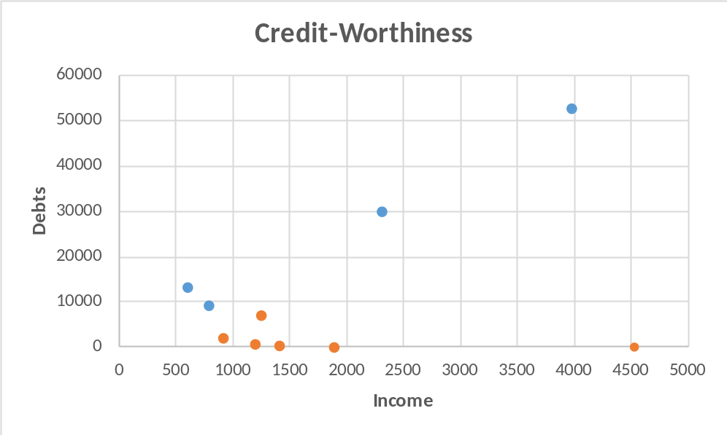
Simple SVM Example
Income | Debts | Credit
1238 | 7002 | Low
602 | 13081 | Low
2309 | 30002 | Low
1186 | 899 | High
791 | 8989 | Low
1888 | 0 | High
1400 | 421 | High
3971 | 52776 | Low
910 | 2001 | Low
4522 | 10 | High
Plot of the data:

Slide 18

Simple SVM Example
Income | Debts | Credit
1238 | 7002 | Low
602 | 13081 | Low
2309 | 30002 | Low
1186 | 899 | High
791 | 8989 | Low
1888 | 0 | High
1400 | 421 | High
3971 | 52776 | Low
910 | 2001 | Low
4522 | 10 | High
2 descriptive features
→ hyperplane has dimension 2-1= 1

Slide 19
Simple SVM Example
Income | Debts | Credit
1238 | 7002 | Low
602 | 13081 | Low
2309 | 30002 | Low
1186 | 899 | High
791 | 8989 | Low
1888 | 0 | High
1400 | 421 | High
3971 | 52776 | Low
910 | 2001 | Low
4522 | 10 | High
2 descriptive features
→ hyperplane has dimension 2-1= 1
We transform the problem to an optimization problem as shown in the lecture…

Slide 20
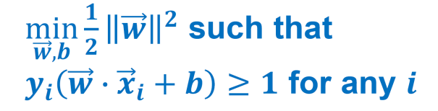
Simple SVM Example - Solution
Income | Debts | Credit
1238 | 7002 | Low
602 | 13081 | Low
2309 | 30002 | Low
1186 | 899 | High
791 | 8989 | Low
1888 | 0 | High
1400 | 421 | High
3971 | 52776 | Low
910 | 2001 | Low
4522 | 10 | High

Slide 21
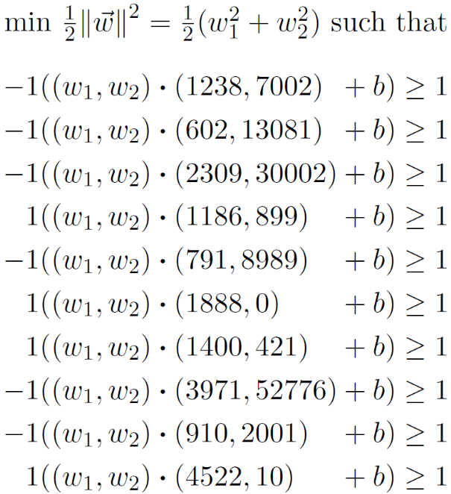
Simple SVM Example - Solution
Income | Debts | Credit
1238 | 7002 | Low
602 | 13081 | Low
2309 | 30002 | Low
1186 | 899 | High
791 | 8989 | Low
1888 | 0 | High
1400 | 421 | High
3971 | 52776 | Low
910 | 2001 | Low
4522 | 10 | High

Slide 22
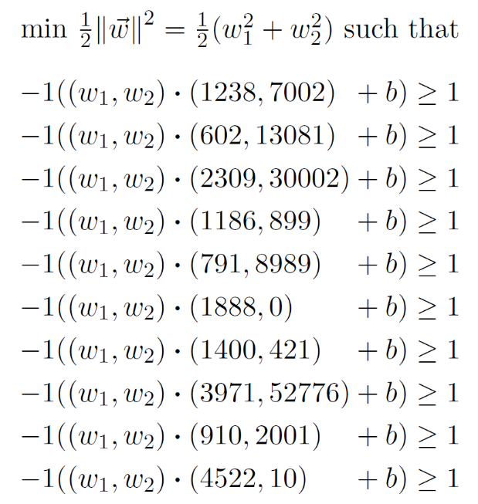
Simple SVM Example - Solution
Income | Debts | Credit
1238 | 7002 | Low
602 | 13081 | Low
2309 | 30002 | Low
1186 | 899 | High
791 | 8989 | Low
1888 | 0 | High
1400 | 421 | High
3971 | 52776 | Low
910 | 2001 | Low
4522 | 10 | High
We don‘t want to solve this manually! ☺

Slide 23
Simple SVM Example
Hotel Cost | Distance from Center | Visitor Max Budget | Hotel booked?
25 | 5 | 50 | y
110 | 2 | 30 | y
49 | 6 | 100 | y
123 | 11 | 200 | n
88 | 15 | 300 | n
41 | 2 | 20 | n
67 | 10 | 35 | n
93 | 5 | 40 | n
29 | 3 | 40 | y
158 | 1 | 70 | n
Your turn!
Formulate the optimization problem for finding the best hyperplane classifying the given data!

Slide 24
Simple SVM Example - Solution
Hotel Cost | Distance from Center | Visitor Max Budget | Hotel booked?
25 | 5 | 50 | y
110 | 2 | 30 | y
49 | 6 | 100 | y
123 | 11 | 200 | n
88 | 15 | 300 | n
41 | 2 | 20 | n
67 | 10 | 35 | n
93 | 5 | 40 | n
29 | 3 | 40 | y
158 | 1 | 70 | n

Slide 25
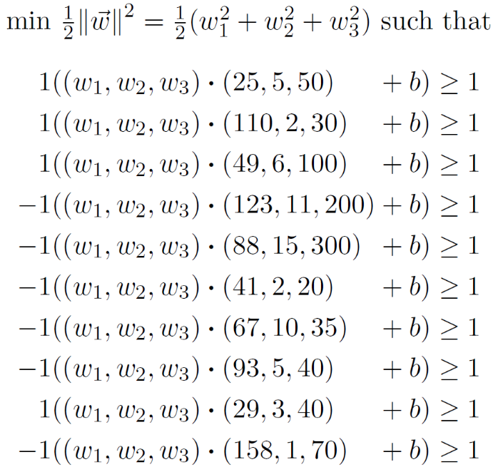
Simple SVM Example - Solution
Hotel Cost | Distance from Center | Visitor Max Budget | Hotel booked?
25 | 5 | 50 | y
110 | 2 | 30 | y
49 | 6 | 100 | y
123 | 11 | 200 | n
88 | 15 | 300 | n
41 | 2 | 20 | n
67 | 10 | 35 | n
93 | 5 | 40 | n
29 | 3 | 40 | y
158 | 1 | 70 | n

